Slide 1
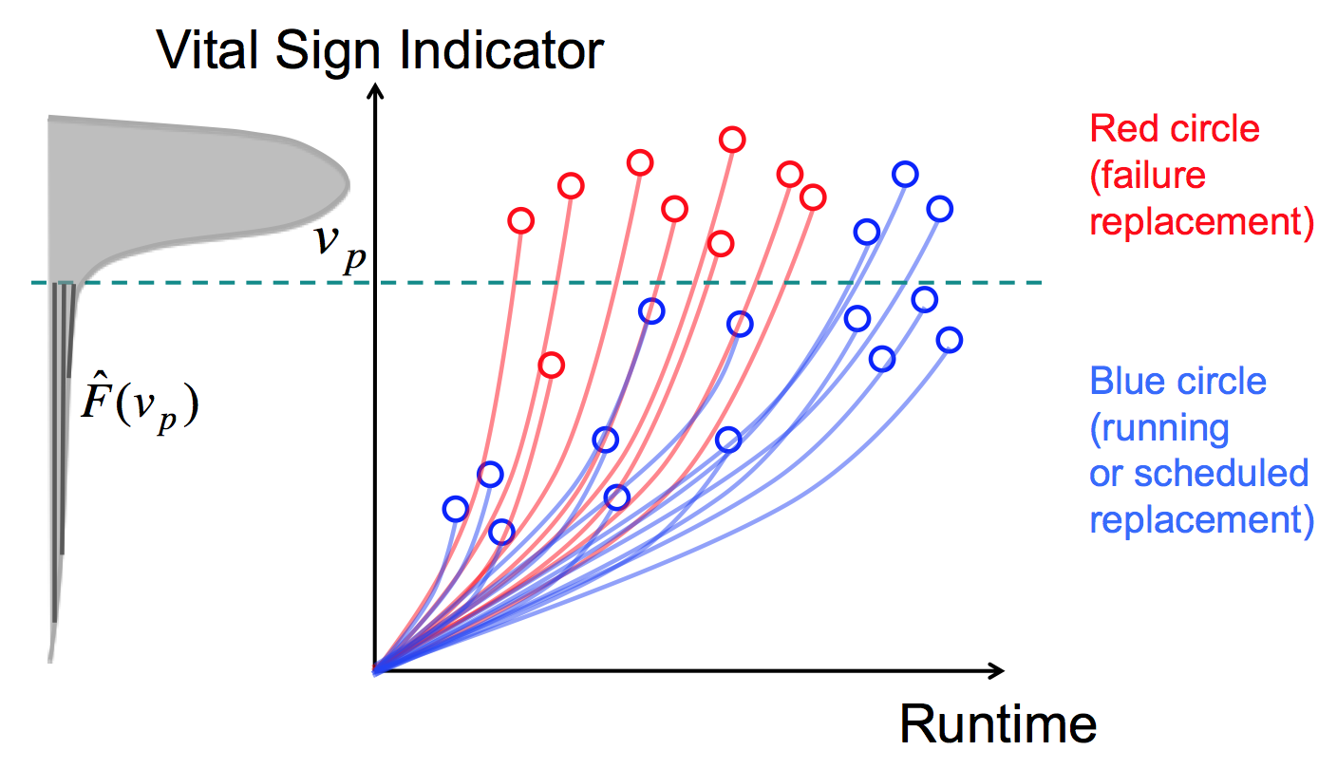
Building Hierarchical Failure Risk Models
Failure risk model
A failure risk model is built on each failure mode. This failure mode-level risk model assesses the failure risk with which a component has failure of the mode in component hours since the latest failure
Component-level failure risk model can be built combining the failure mode-level risk models in a component type (functional location)
Unit-level failure risk model can be built combining component-level failure risk models.
Failure Indicator
Component Hours
since the latest failure
Failure indicator values tend to rapidly increase near the actual failure
A threshold-based replacement policy can be designed based on this failure indicator
BMA 797F Truck Optimization FTO
Privileged and Confidential

Slide 2
Individualized Failure Indicator
Failure risk model
Individualized Failure Indicator
= Cumulative Failure Probability over component cycles (or component usage time) individualized for each component considering its real usage conditions
e.g., severe usages or harsh conditions may increase the likelihood of failure
Ideal failure indicator values should tend to rapidly increase near the actual failure
A threshold-based replacement policy can be designed based on this failure indicator
Failure Indicator
Component
Cycles
Notes:
Failure Probability/Hazard for each cycle is modeled by Classification/CoxPH

Slide 3
Failure risk model
Classification + Time-dependent CoxPH
A data-driven ML function model for the failure risk indicator is to combine a failure classification task with the time-dependent CoxPH model.
First, we generate time-based sample points (e.g., one sample per day (or per cycle) from healthy and failure components. Each sample point has features calculated over the last N-days (N-cycles) time window.
Second, we label as “Unhealthy class” only the sample points within a pre-specified time window (a model parameter) ahead of the failure time of each failure component. Other remaining sample points are labeled “Healthy class”. This assumes that the failure component was in unhealthy state with this specified time window.
Time Window – Variable Parameter for classification label
Unhealthy
Healthy
Component Install
Failure

Slide 4
Failure risk model
Third, we perform a classification task to classify healthy samples vs. unhealthy samples. This classification task also estimates the instant failure probability of each sample point.
Fourth, we use the instant failure probability estimate as one covariate in the time-dependent CoxPH model. Using the instant hazards over time from the time-dependent CoxPH model, we obtain a cumulative failure probability for an individual component over time and use it as our failure risk indicator.
Note that the failure risk indicator based on a cumulative failure probability is monotonically increasing over time and enables us to make a threshold-based maintenance policy in terms of the failure risk indicator.

Slide 5
Component-level failure risk model (on a failure mode)
Failure risk model
1. Cox PH model with time-dependent covariates
Instant Hazard
A covariate with more frequent failures
will have larger estimated beta
where x_{k} (t) are time-dependent covariates
Cumulative Hazard H(t) = Σ_{t} h(t)
Cumulative Failure Probability P(t) = 1 – exp (-H(t) )
2. Classification model
(e.g.) logistic model, SVM, RandomForest
Set the instant hazard h(t) = Pr(t)
= Classification Failure probability at t
Cumulative Hazard H(t) = Σ_{t} h(t)
Cumulative Failure Probability P(t) = 1 – exp (- α H(t) )

Slide 6
Component-level failure risk model (on a failure mode)
Failure risk model
3. Classification model & Cox PH model with time-dependent covariates
Set the covariate x(t) = Pr(t) = Classification Failure probability at t
(from Classification task)
Instant Hazard
where x(t) = Pr(t) = classification failure probability
Cumulative Hazard H(t) = Σ_{t} h(t)
Cumulative Failure Probability P(t) = 1 – exp (-α H(t) )

Slide 7
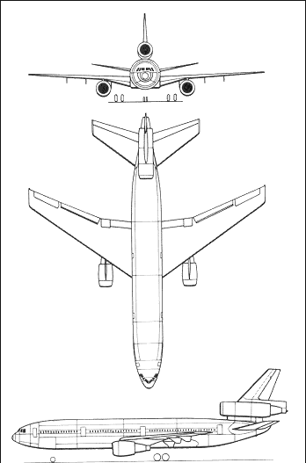
Analytic Output - Probability of Delay or Cancellation By Tail
Failure risk model
Tail Number P(failure) = Aggregated Component P(failure)
Starter Air Valve
Multiple Models to Aggregate Risk:
P_{tail} (t) = max { P_{j} (t) }
P_{tail} (t) = 1 - (1 - P₁ (t)) (1 - P₂ (t)) ... (1 - P_{J} (t))
P_{tail} (t) =
Thrust Reverser
Brakes
AC Generation
Bleed Valves
Method is Scalable to as many component models required to achieve desired fidelity and business outcome.
Etc …

Slide 8
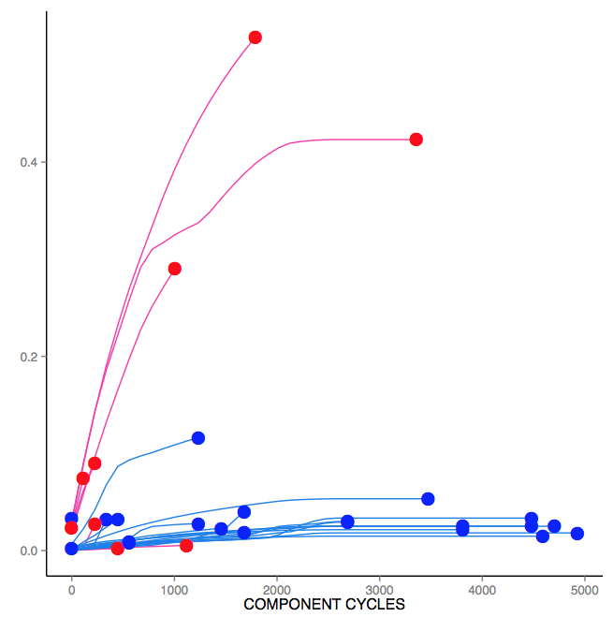
Individualized Failure Indicator for Engine Oil Leakage Failure Mode
(Example) Failure risk model
Generate Individualized Failure risk curves, for each engine.
An optimal threshold to schedule inspections could be calculated.
Individualized Failure Indicator
= Cumulative Failure Risk Score
over engine hours for each
component
A threshold-based inspection policy can be designed based on this failure indicator
Individualized cumulative failure risks score for a given component are calculated for each one, based on its VIMS characteristics
Individualized Failure Indicator
Each line represents one engine
Red represents engine where engine oil leakage failure occurred
Blue represents engines without engine oil leakage failure
Inspection action threshold
Engine Hours
Note: The scheduled inspection varies from engine to engine (different # of cycles)

